Slide 1
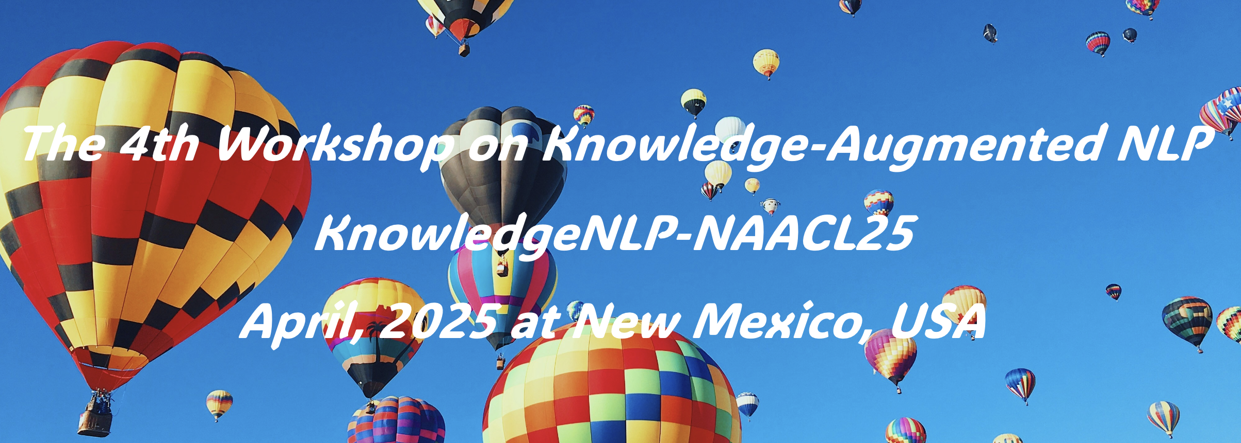







Introduction Advancements in large language models have significantly improved natural language processing but face challenges with rare data and inaccuracies. Knowledge-augmented NLP methods address these by integrating external knowledge, enhancing model performance, and bridging the gap between statistical analysis and comprehensive world understanding, thereby boosting efficiency and effectiveness in NLP.
Call for Papers
1. All about knowledge data: automatic or human-driven approaches for gathering, curating, and constructing knowledge corpus/databases.
2. All about knowledge acquisition: web-based retrieval, tool/API usage, structured knowledge, and other techniques for sourcing related knowledge.
3. All about knowledge utilization: pre-training, fine-tuning with knowledge, plug-and-play knowledge injection, knowledge editing, and updating in LMs.
4. Knowledge in diverse modalities and novel applications: knowledge-augmented visual/code/math LMs or applications such as chemistry, education, etc.
5. Language models as parametric knowledge bases: distillation and knowledge elicitation from LLMs and applications such as generative retrieval, recommendation.
Organizers
Weijia Akari Wenhao Greg Meng Hannaneh Luke
Shi Asai Yu Durrett Jiang Hajishirzi Zettlemoyer

